Slide 1

Supply Chain Data Analytics Capstone
Rutgers University Data Analytics Bootcamp
Isabel Tavares

Slide 2
Business Problem & Objectives
Business Challenge
Supply chain organizations generate large amounts of operational data every day. However, without proper analysis, valuable information remains hidden, making it difficult for managers to optimize inventory, improve logistics, monitor quality, and increase profitability.
Project Objectives
This project answers fourteen business questions designed to identify:
• Which products perform best
• Which customer groups generate the most revenue
• Which suppliers operate most efficiently
• Which transportation methods minimize costs
• Which quality issues require attention
• Whether inventory levels align with product demand

Slide 3

Data Preparation & Methodology
Step 1 – Understanding the Dataset
The dataset included information about:
Products
Suppliers
Transportation
Shipping
Inventory
Customer demographics
Product inspections
Revenue
Step 2 – Data Cleaning
The data was reviewed for:
Missing values
Duplicate records
Data type inconsistencies
Currency formatting
Numerical conversion
Category consistency
Step 3 – SQL Analysis
SQLite was used to answer fourteen business questions.
Step 4 – Tableau Visualization
The SQL results were transformed into interactive dashboards.

Slide 4
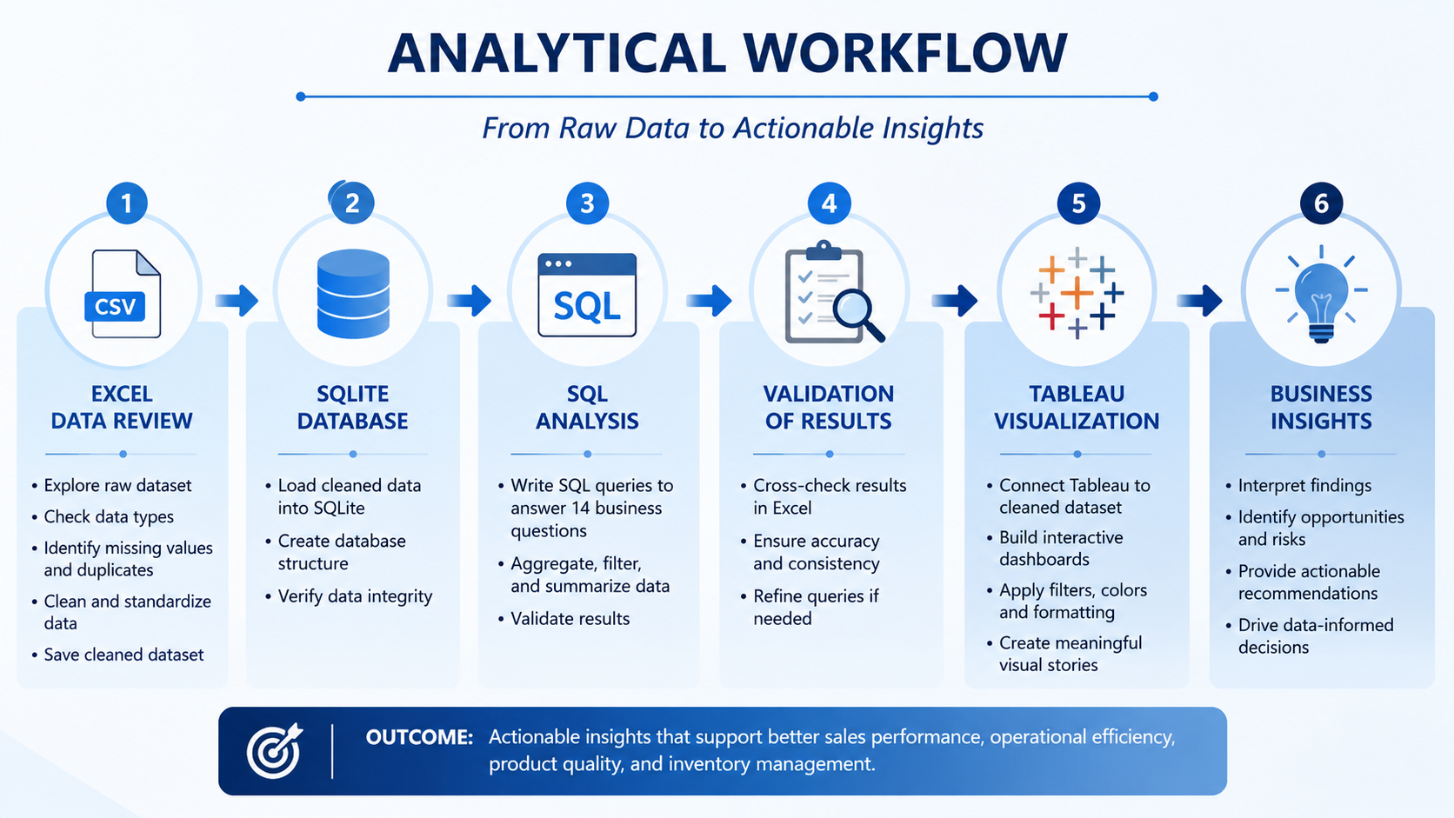

Slide 5
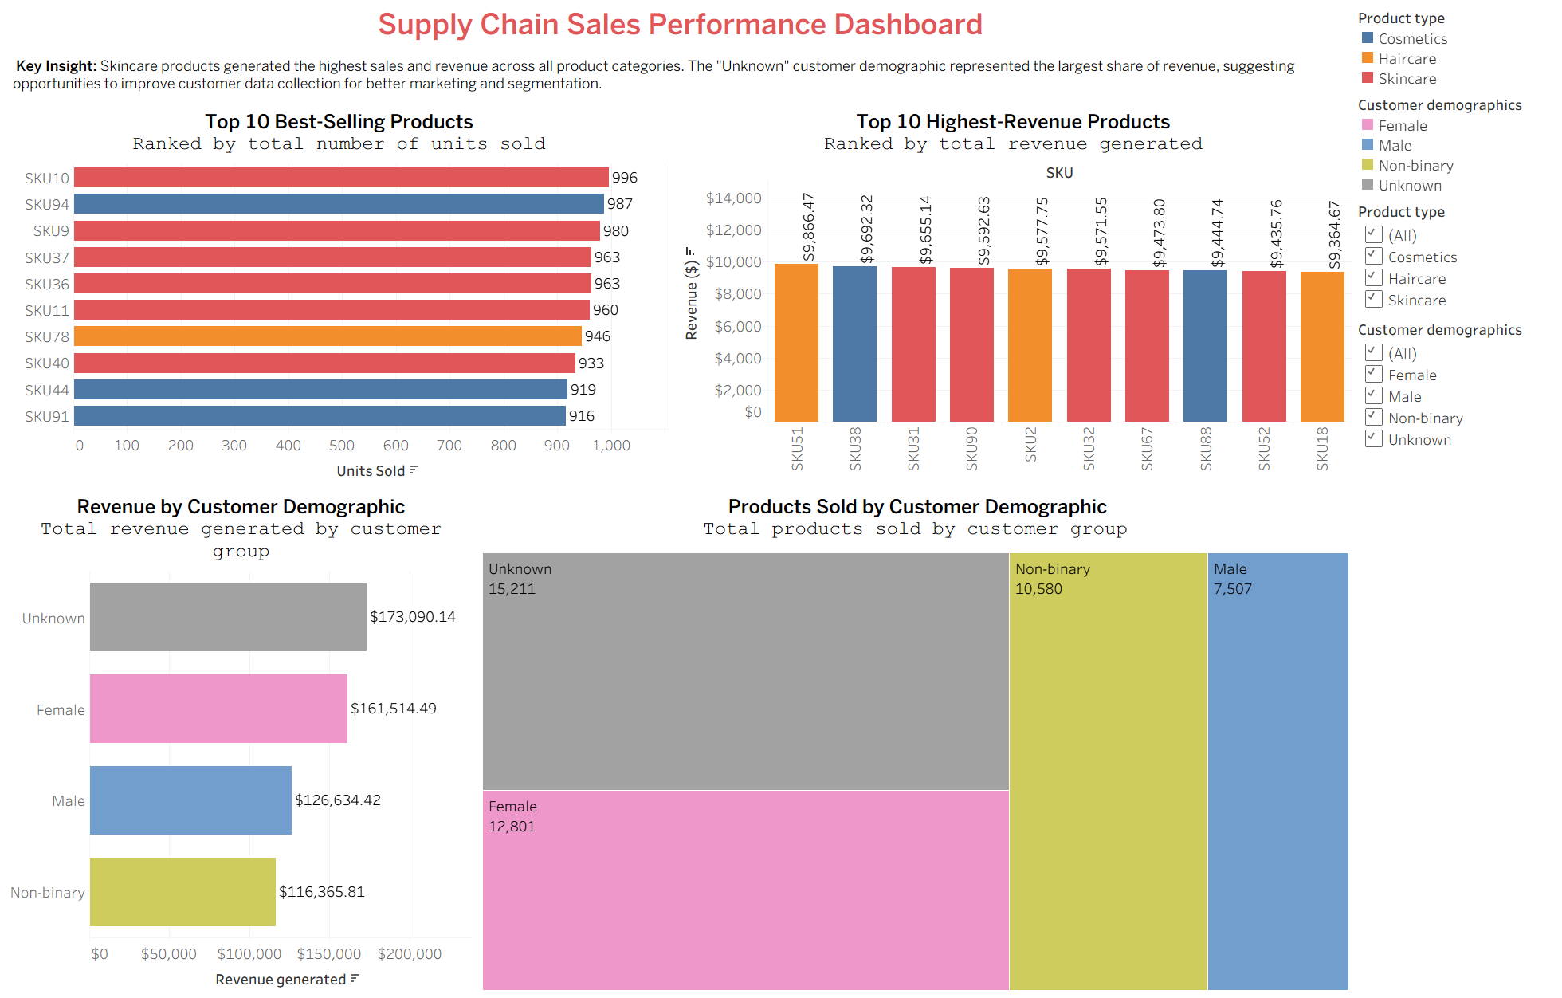

Slide 6
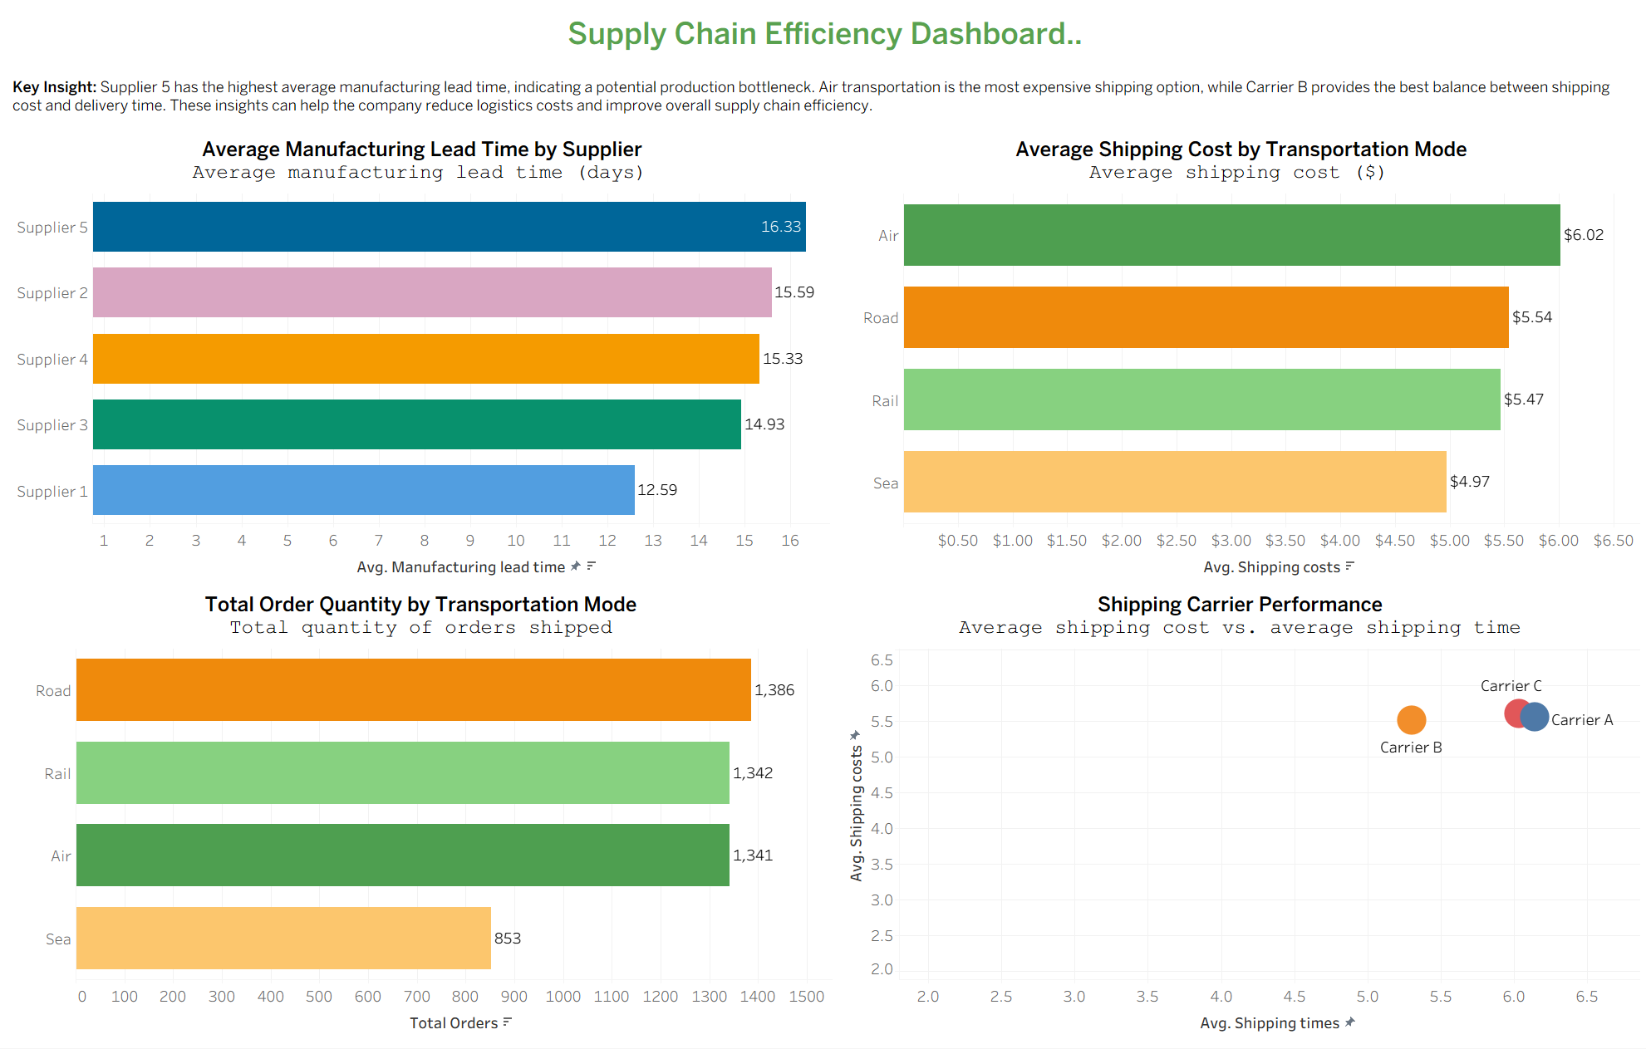
Notes:
Key Findings
• Supplier 5 has the longest manufacturing lead time.
• Air transportation is the most expensive shipping option.
• Road transportation carries the largest order volume.
• Carrier B provides the best balance between shipping time and cost.
The second dashboard evaluates operational efficiency.
Instead of focusing on sales, this dashboard examines suppliers, transportation methods, and logistics.
Supplier 5 recorded the highest average manufacturing lead time, suggesting a potential production bottleneck.
Transportation analysis revealed that Air shipping has the highest average shipping cost, which is expected due to faster delivery speeds.
However, Road transportation handled the largest order volume, making it the primary transportation method.
Finally, by comparing shipping cost with delivery time, Carrier B demonstrated the best balance between operational efficiency and cost.
These findings could help managers negotiate supplier contracts and optimize transportation strategies.

Slide 7
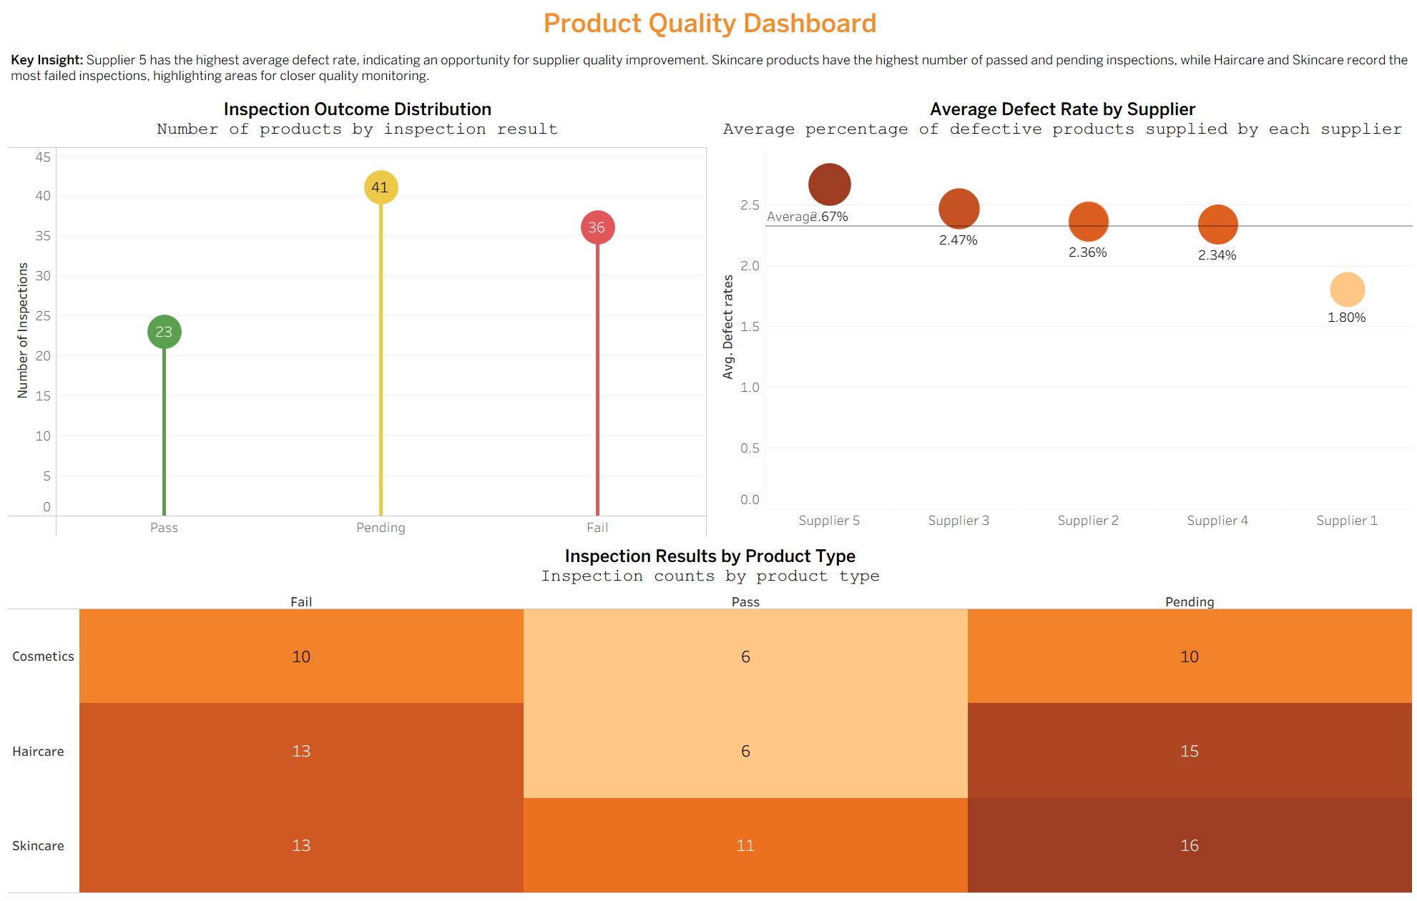

Slide 8
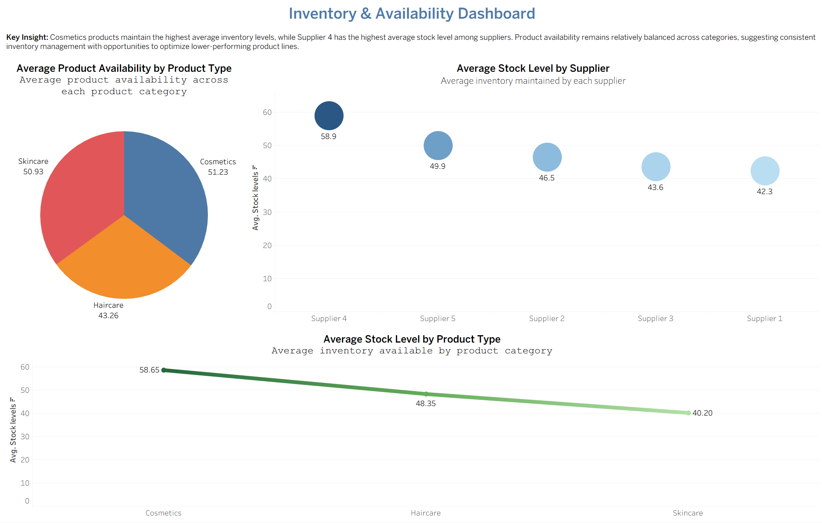

Slide 9

Business Recommendations
Improve Customer Data Collection
Capture complete customer demographic information during the sales process to support customer segmentation and targeted marketing.
Optimize Supplier Performance
Work with Supplier 5 to reduce manufacturing lead times and improve product quality through regular performance reviews.
Strengthen Quality Control
Increase inspections for Haircare and Skincare products and monitor pending inspections to reduce defect rates.
Improve Logistics Efficiency
Continue using Carrier B for balanced shipping cost and delivery performance while evaluating opportunities to reduce Air transportation costs.
Optimize Inventory Planning
Review inventory policies for lower-performing product categories and align stock levels with product demand to reduce excess inventory while maintaining availability.

Slide 10

Conclusion
✔ Successfully transformed raw supply chain data into meaningful business insights.
✔ Applied the complete analytics workflow from data preparation to dashboard development.
✔ Answered fourteen business questions using SQL analysis.
✔ Developed four interactive Tableau dashboards to support business decision-making.
✔ Demonstrated how data analytics can improve sales, operations, quality management, and inventory planning.

Slide 11
Thank you

